Slide 1







MTA Daily Ridership Analytics Dashboard
Post-Pandemic Recovery for New York City's Transportation Network
Supervisor:
Eng. Osama Adel
14 / 7 / 2026

Slide 2









Meet Our Team
Rofaida Ahmed
Habiba Mahmoud
Sara ElHattab
Amr Ahmed
Mohamed Waled
Mohamed Ahmed

Slide 3


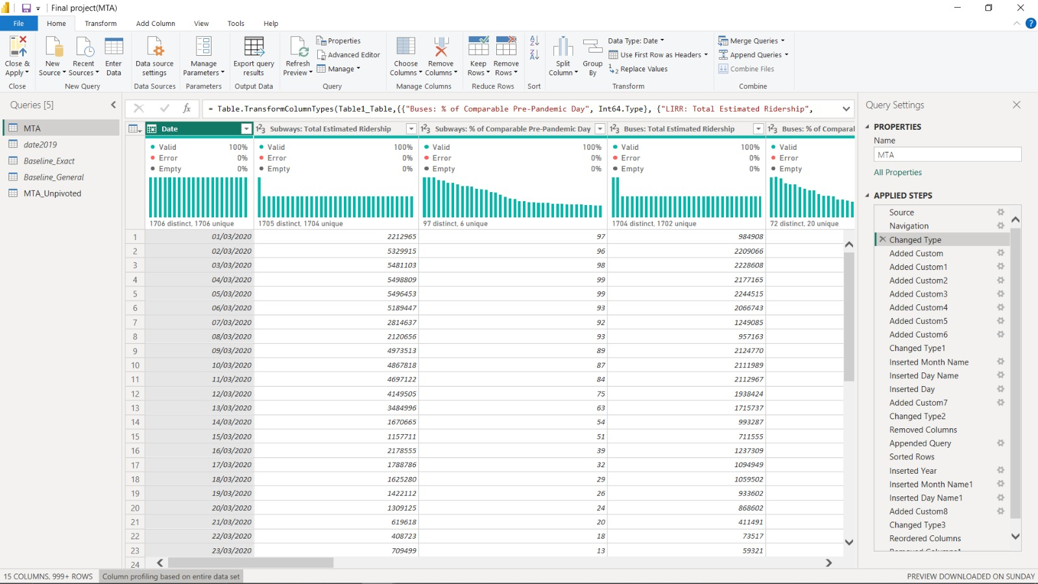
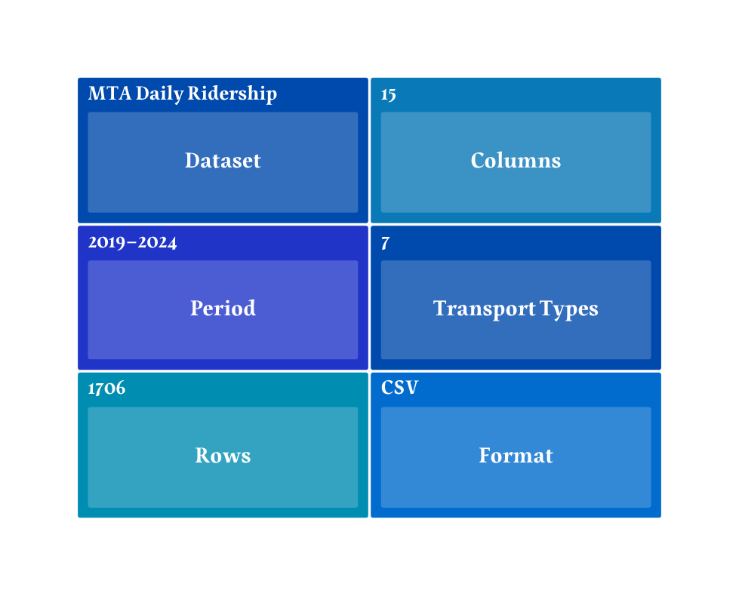
Dataset Overview

Slide 4
Data Preparation
Combined annual transportation dataset files into one single consolidated table (MTA) for a continuous time-series analysis (2019 - 2024).
Data Append
Transformed wide transport type columns into a narrow format (Transport Type & Ridership Volume) to optimize Power BI performance and storage.
Data Unpivot
Baseline 2019
Aggregated data by Month, Day, and Day Type (Weekend/Weekday) for granular level and high-accuracy trend comparisons.
(Detailed Group By)
Baseline 2019
Grouped data by Month and Day Type only to speed up dashboard processing and optimize KPI card performance.
(Aggregated Group By)

Slide 5
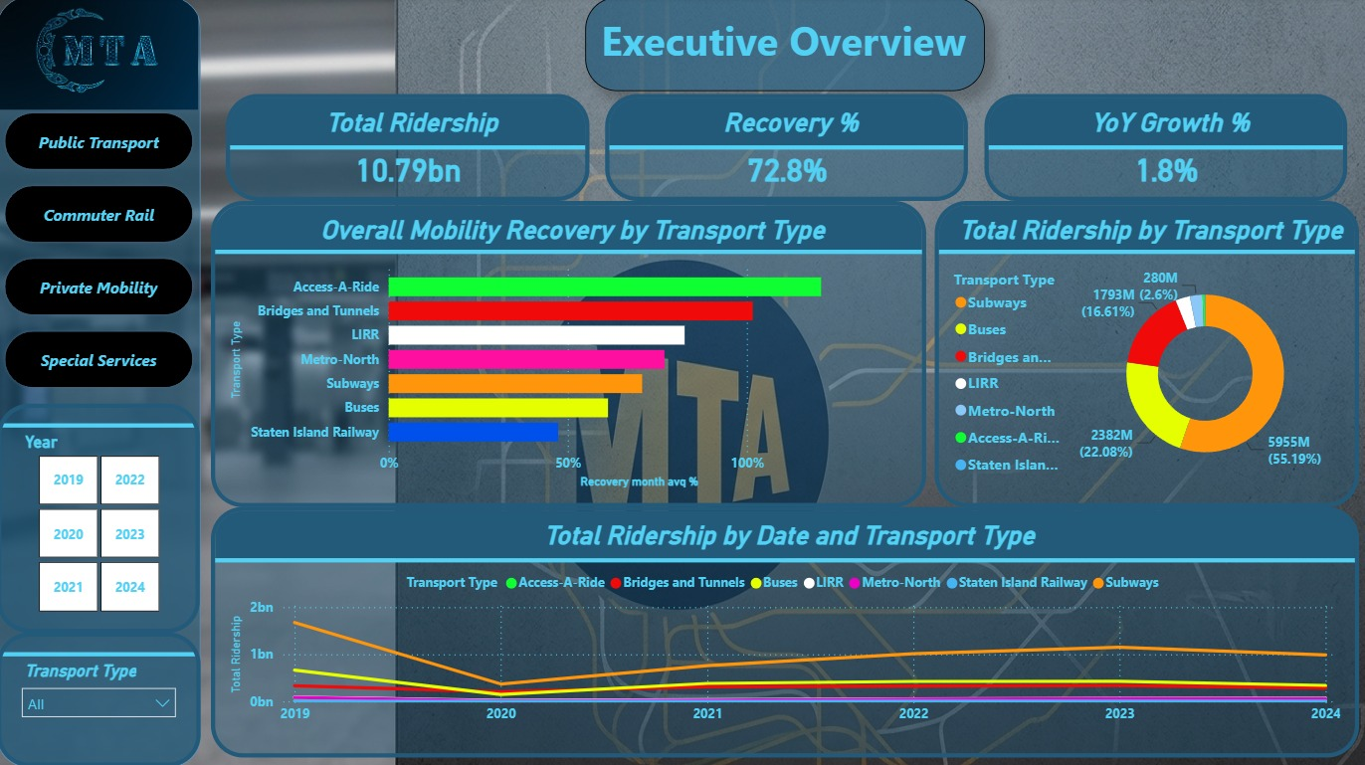

Analyzing the impact and recovery of New York City's transportation network after the COVID-19 pandemic
Project Overview :
Objective
Monitor ridership
Measure recovery
Analyze yearly performance
Support operational decisions
Compare transportation modes

Slide 6
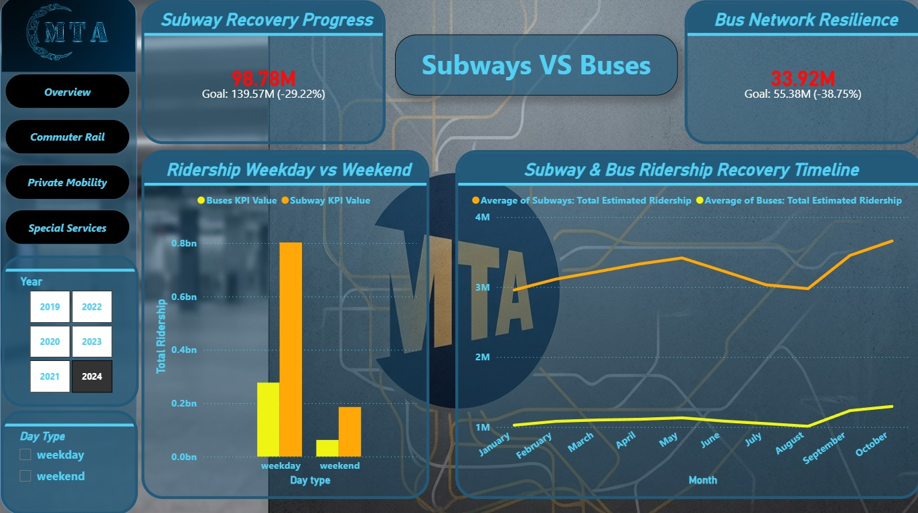
Key Features
Recovery KPIs
Interactive Filters
Monthly Ridership Timeline
Weekday vs Weekend Analysis
Monitor and compare the recovery of Subways and Buses

Slide 7
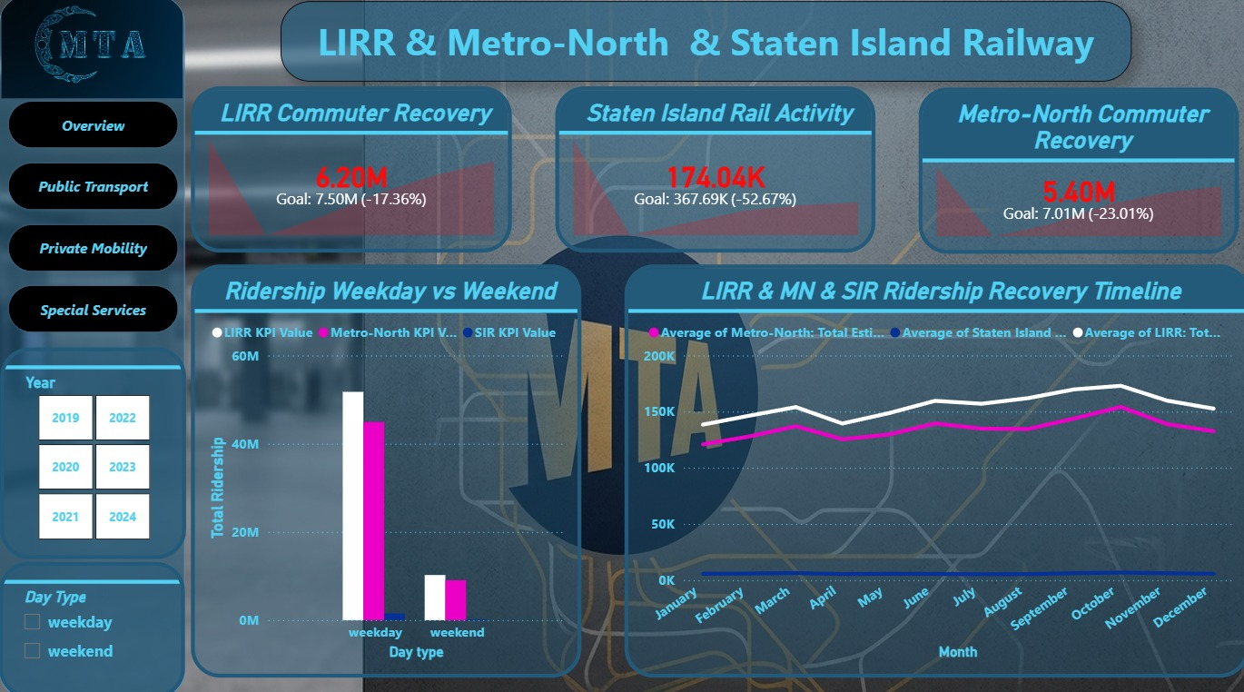
Key Features
Recovery KPIs
Interactive Filters
Monthly Ridership Timeline
Weekday vs Weekend Analysis
Analyze the recovery of LIRR, Metro-North, and Staten Island Railway

Slide 8
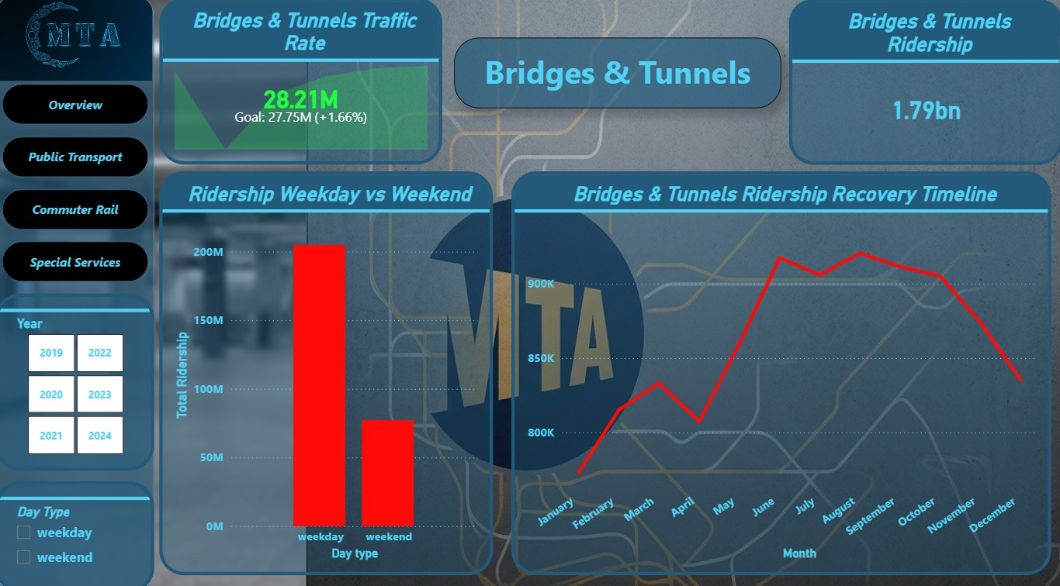
Key Features
Total Ridership
Traffic Rate KPI
Monthly Recovery Timeline
Weekday vs Weekend Analysis
Analyze the performance and recovery of Bridges & Tunnels traffic

Slide 9
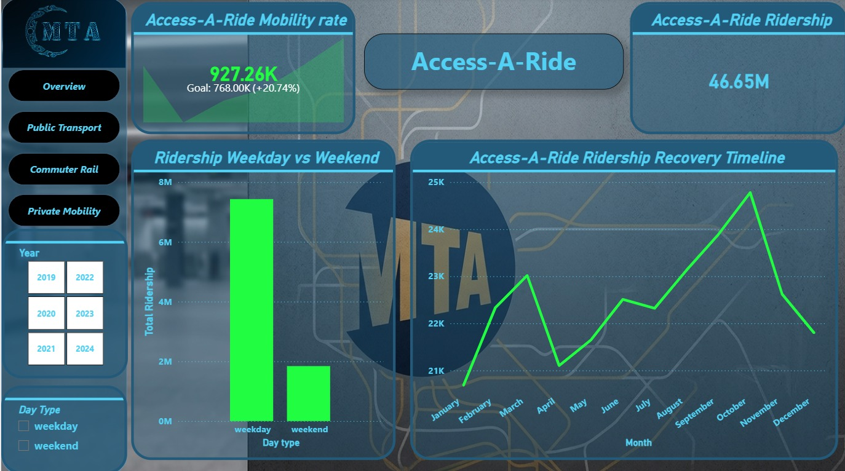
Key Features
Total Ridership
Mobility Rate KPI
Monthly Recovery Timeline
Weekday vs Weekend Analysis
Analyze the recovery of LIRR, Metro-North, and Staten Island Railway

Slide 10

Insigths :
Overall Trend
Fastest Recovery
Highest Ridership
Seasonal pattern
Recovery Comparison
Weekday Vs Weekend
Business recommendations :
Monitor ridership data regularly
Increase Service Frequency During Peak Hours
Develop strategies to encourage public transportation types
Focus on improving lower-performing transportation modes

Slide 11
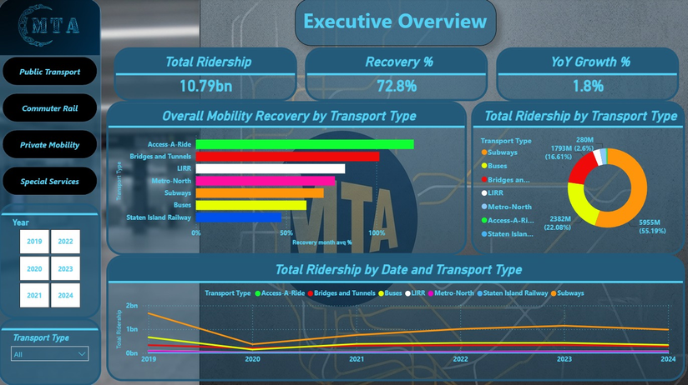







Slide 12




Any Questions

